Slide 1


SAP Full-Stack Developer training
ABAP on HANA, UI5 & Fiori, Analytics with OData
Anubhav Oberoy
Day – 7

Slide 2

Agenda – Day 7
Introduction to OData Services
Consuming Northwind OData Services from UI5 Application
Deployment Options
Deploying Ui App into Fiori Launchpad
Fiori Launchpad Configuration For Tiles

Slide 3

Introduction to OData Services
OData is open data protocol, it is used to create REST based services, initially developed by the OASIS company later acquired by Microsoft and make open source.
REST – Representational State Transfer – also known as STATELESS Communication
OData was developed by Microsoft in 2007 and later they made it open source.
Presentation
Fiori
SAP_UI
http request
response
OData
Software Innovation
Hardware Innovation
Hana
Note: Fiori Only and Only Understand OData.

Slide 4
OData Basic
When we call a service, it loads a service document, a service document includes multiple OData Entity Sets inside. Each service also has a metadata document which explains about properties inside of each entity set.
Service Document (Collection of Entity Sets) – 1 Entity Set = 1 DB Table
https://services.odata.org/V2/(S(gte5obp1xr5gdvcqffzwbrwq))/OData/OData.svc/
Service metadata (/$metadata) – all the entity types and entity sets
Entity Type is the blue print of data set, entity set is the access point of actual data
https://services.odata.org/V2/(S(gte5obp1xr5gdvcqffzwbrwq))/OData/OData.svc/$metadata
Access Multiple Records of an Entity Set (SELECT * FROM dB table)
https://services.odata.org/V2/(S(gte5obp1xr5gdvcqffzwbrwq))/OData/OData.svc/Products?$format=json

Slide 5
Format of an OData URL
http(s)://hostname:port/sap/opu/odata/sap/SERVICENAME_SRV/ENTITYSET?p1=val&p2=val
Protocol
Adress & Port
Path prefix
Service Name
End Point Access Data
Query Options

Slide 6
Client Side Query with OData
02
$top
01
03
$format
$skip
ODATA Query
06
04
$expand
$select
05
$filter

Slide 7
SAP OData V2 (Version 2)
OData v2 is a set of new standards which are add-ons to SAP OData V1, and these are as follows:
Client-side sorting and filtering
All requests can be batched
All data is cached in the model
Automatic Message handling
You can read more about SAP OData v2 vs OData v1 here.
Northwind OData service
Northwind is publicly available OData service. You can use this freely available OData service to learn how to use and consume OData service in SAPUI5 applications with SAP WebIDE.
https://services.odata.org/V2/Northwind/Northwind.svc/
More free OData service: https://services.odata.org/

Slide 8
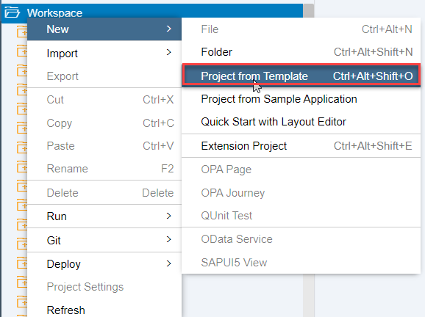
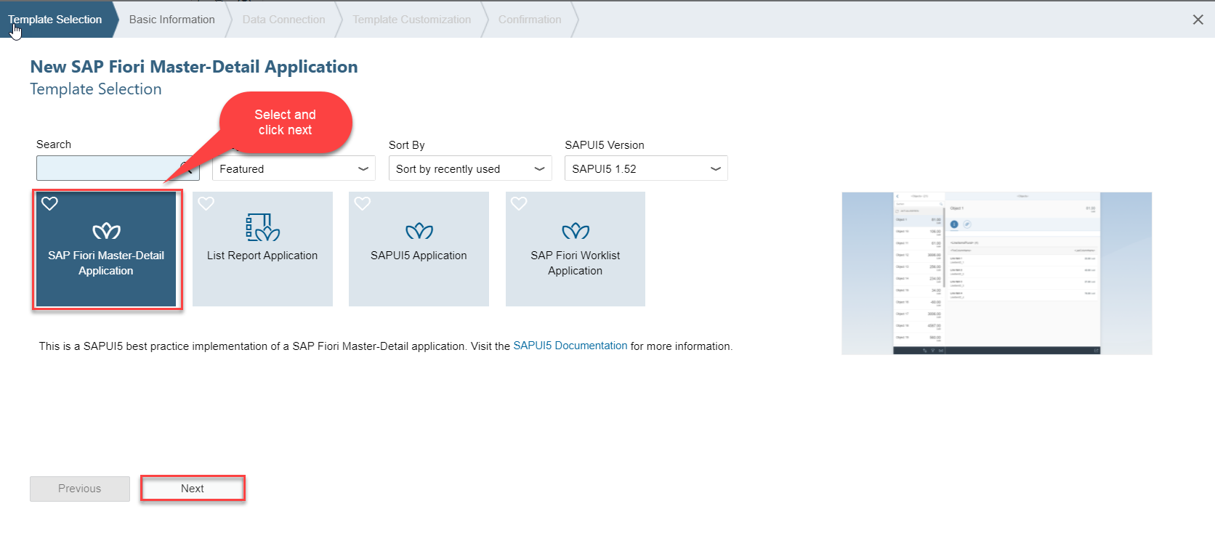
Consuming Northwind OData service
Step1: Destination file for northwind Odata service click here
And for more click
Step2: Create a fiori app from template
Step3: Template selection: Select Sap Fiori Master Detail Application

Slide 9
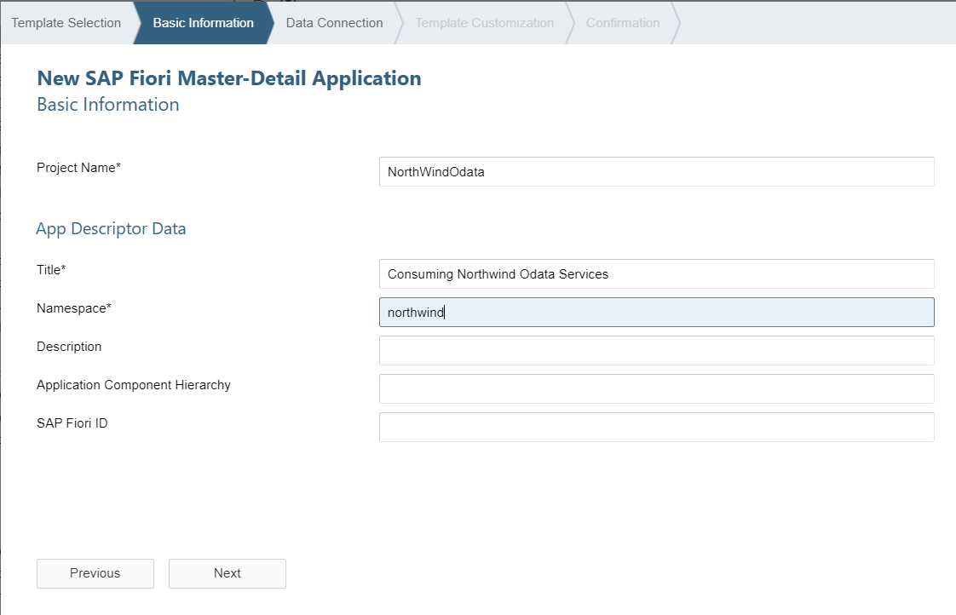
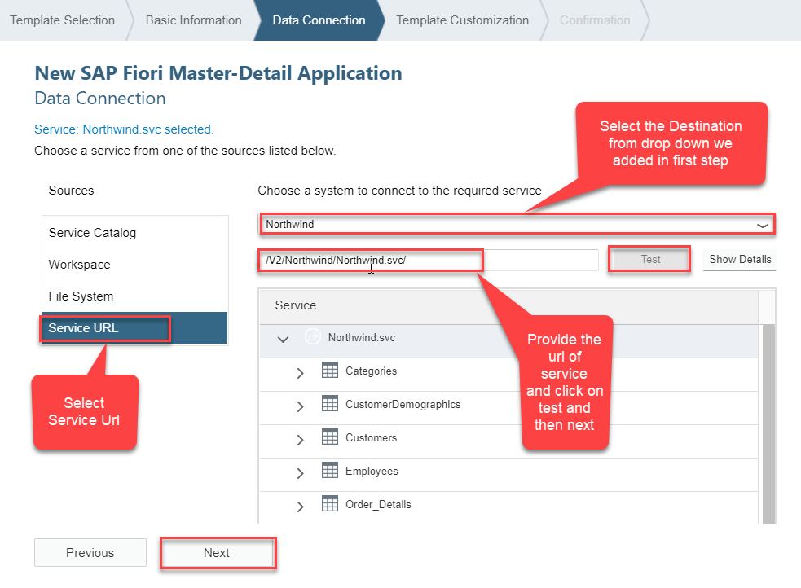
Consuming Northwind OData service
Step4:Fill the basic information and click on next
Step5: Set the Data Connection and you are done.

Slide 10
Deployment options
Presentation
Option 1: Fiori Central HUB Deployment
Advantage
Able to use Fiori – adapt innovation
We are able to connect now multiple such backend
Separation of duties
More security
Upgrade free
Disadvantage
Cost
Confusion
Manage security double
Functionality is distributed
Redundancy
Latency
SAP Netweaver 7.4
Fiori Frontend System – FES
Gateway system
Fiori
SAP_UI
RFC – SM59
SAP ERP(Application Layer)
Existing functionality and data
Backend -- BES
SAP CRM
SAP SRM
Database
Database
Database

Slide 11
Deployment options
Presentation
Option 2: Embedded Deployment
Advantage
Low Cost
Confusion is gone
No need to create RFC – LOCAL
Setup is much easier
Security is at one place
Low latency
Still use this system as a HUB in future
Disadvantage
We must be on SAP Netweaver 7.4
If the system is down, both fiori and classical functionality will not work.
RFC – SM59
Fiori
SAP_UI
SAP ERP(Application Layer)
Existing functionality and data
Database
https://www.sap.com/documents/2018/02/f0148939-f27c-0010-82c7-eda71af511fa.html
SAP_UI and SAP_GWFND

Slide 12

Break

Slide 13
EPM Data Model
Enterprise Procurement Model – Products, Business Parter (Suppliers and Customers), Orders and Order Items.
BAPIs = Function Modules which are reusable and can be called from another systems as well
BAPI_EPM*
BAPI_EPM_PRODUCT_GET_LIST – All the list of products in the system
BAPI_EPM_PRODUCT_GET_DETAIL – details of a single product
BAPI_EPM_PRODUCT_CREATE – create a new product
BAPI_EPM_PRODUCT_UPDATE – update existing product
BAPI_EPM_PRODUCT_DELETE – delete the product
Business partners (BP)
BAPI_EPM_BP_GET_LIST
BAPI_EPM_BP_GET_DETAIL
BAPI_EPM_BP_CREATE
BAPI_EPM_BP_UPDATE
BAPI_EPM_BP_DELETE
CRUD

Slide 14
TCode
SEGW – Service Builder
/N/IWFND/MAINT_SERVICE – Registration of services
/N/IWFND/ERROR_LOG – Error logs of service calls
/N/IWFND/GW_CLIENT – test services locally within sap system
ABAP SEGW CLASSES
It has the code which provides the metadata
SAP Generated
It has the code which provides the actual data in the output when EntitySet is called
Runtime Artifacts
MPC
(Model provider Class)
DPC
(Data Provider Class)
MPC_EXT (Extension)
Code which developer will write
DPC_EXT (Extension)
All the ABAP Code which works with CRUD implementations

Slide 15

End of Day 7

Slide 16

Questions

Slide 17

Anubhav Oberoy

Slide 18


We’re committed to empower you to be
Most Desirable Resource
through powerful training solutions.
We build the workforce of the future.
250+
Corporate Clients
30,000+
Learners Trained
25000+
Learners Placed
FREE WEBINARS
Sign up for free webinars with industry experts every fortnight!
Enroll Now!
Contact us today!
https://anubhavtrainings.com/

Slide 19




More from AnubhavTrainings.com

